Slide 1

CMR COLLEGE OF ENGINEERING & TECHNOLOGY
Kandlakoya, Medchal, Hyderabad - 501401
Department of Computer Science and Engineering
Use of machine learning to identify
Fake profiles
Batch No:42
Name of the student:
20H51A0537 K. Harashitha
20H51A05F9 T. Tanujha
Under esteemed guidance of
Guide Name
Dr.G.Ravi Kumar
(Associate Professor)
Batch: 2020-2024 Major Project Phase

Slide 2
Outline
Abstract
Introduction
Literature survey
Existing system
- Problems in existing system
Research Objective of Presentation
Problem Definition
Research work
- Proposed system architecture
- Methods
- Comparison of Proposed system with an existing system
Performance Measure
Results
Conclusion
Future Work
References
Notes:
2

Slide 3
Abstract
Notes:
3

Slide 4
ABSTRACT
Platforms for social media like Facebook, Twitter, Instagram, and others greatly impact our lives. All across the world, people are actively engaged in it.
But, it also needs to address the problem of false profiles.
Fake accounts are regularly made by people, software, or machines.
They are employed in the spread of rumors and illegal actions like phishing and identity theft.
This project uses several machine learning techniques like the decision tree classifier, and KNN classifier to discriminate between fake and authentic.

Slide 5
INTRODUCTION
Notes:
5

Slide 6
Introduction
In pursuing Fake account detection, our project leverages the power of Decision tree classifier.
Meanwhile, It works by recursively partitioning the feature space into smaller regions based on the values of input features, ultimately creating a tree-like structure of decision rules.
By harmonizing these advanced techniques, our project aims to Detect fake profiles using machine learning algorithm and features of the accounts by analyzing the data algorithms
Notes:
6

Slide 7
Literature Survey

Slide 8
Problems in existing system
Problems in existing systems are
Many respectable profiles were detected as fake profiles
The implemented existing systems were time-consuming and expensive
The were only applicable on visible data but not a real time model

Slide 9
Research Objective
Notes:
9

Slide 10
Research objective
The research objective for the project “Use of Machine Learning to identify `Fake Profiles” is to develop and evaluate deep learning models that can accurately identify and classify fake or fraudulent profiles on social media platforms.
Researchers have studied these internet social networks to see their effect on individuals. Researchers have studied these internet social networks.
Despite all the advantages such social sites have their disadvantages as well, in a certain way they pose a threat to unvigilant individuals.
Attacks such as phishing, spoofing, spamming, etc. have become really common. Measures should be taken to either control or detect such attacks. Detect

Slide 11
Problem Definition
Notes:
11

Slide 12
Problem Definition
To develop a system or model that can automatically identify and flag fake or fraudulent user profiles on social media platforms, online forums, dating websites, or any online platform where user profiles are created. Detecting fake profiles is crucial for maintaining online communities and platforms integrity, security, and trustworthiness.

Slide 13
Research Work
Notes:
13

Slide 14
Research work
Detection of Various Types of Fake Profiles: The project aims to detect a wide range of fake profiles on digital platforms, including social media, dating sites, and other online communities.
Profile Text and Image Analysis: The scope includes analyzing both textual content (profile descriptions, followers, posts, etc.) and images associated with profiles.
Real-time and Batch Processing: The project addresses real-time or batch processing to identify fake profiles as they are created or encountered on the platform.
Evaluation Metrics: The project intends to use standard evaluation metrics like accuracy, precision, recall, and F1-score to assess the effectiveness of the deep neural network models.

Slide 15
Proposed system

Slide 16
Proposed system
We specifically reviewed the aspects of detecting fake profiles on social media by using machine learning approaches, namely, data collection, feature engineering, construction of fake profile detection model, and evaluation of constructed detection models.
using machine learning to detect fake profiles on social media involves both front-end and back-end components to create a comprehensive system.
Environments like GOOGLE COLAB, and ANVIL WORKS are used in developing this model
Web application is created in Anvil Works. A complete server-side Python environment that allows us to import any packages we want is provided by Anvil's Server Modules. Anvil also allows us to connect to the code which is written in Google Colab directly without any other environments. The code is developed in Python language

Slide 17
Proposed system
Machine Learning Algorithm:
When building a decision tree using the CART (Classification and Regression Tree) technique, the Gini index is a measure of purity or impurity. It is better to choose an attribute with a low Gini index over one with a high index. The CART algorithm only produces binary splits, and it does so by utilizing the Gini index. The formula follows.
Gini Index= 1- ∑_{j}P_{j}²

Slide 18
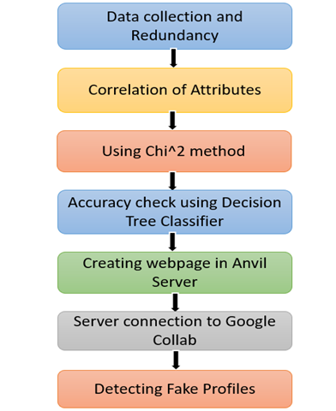
Proposed system Architecture

Slide 19
Comparison table for the existing system
S.No | Authors and Journal Name& Year of publication | Problem Statement | Name of the Proposed solution/Method | Solution | Remarks
1 | K. Harish, R. Naveen Kumar, Dr. J. Briso Becky Bell IJSRSET March-April-2023 | False accounts sharing incorrect and unsuitable information cause conflicts. More people are harmed by phony profiles than by other internet crimes. | XG Boost, a random forest technique, and multi layered neural network. | By using XG Boost, a random forest [19] technique, and observable features from a multi layered neural network focusing on profiles. The retrieved features that were recorded in a CSV file may be read by the model with ease. The model's training, testing, and analysis will ultimately reveal if a profile is real or not. | The authors of the report claim that many respectable people were mistakenly classified as false positives because they shared IP phone numbers and addresses with Sybil.
2 | Pradeep Kumar Roy andShivamChahar IEEE Transactions on Artificial Intelligence, Vol. 1, No. 3, DEC 2020 | Many fake accounts are created for specific purposes. The primary purpose of fake accounts is to spread spam content, rumor, and other unauthentic messages on the platform. Hence, it is needed to filter out the fake accounts, | The methodology used is Machine Learning and Neural Networks. | 1) using nontextual (account-based) features; 2) re search using textual features; and 3) research using both textual and nontextual features. The textual and account-based features have been explained in detail. The researcher may either use existing features or add new features after reviewing the current collection of features to improve the prediction accuracy | The acurracy of the data is more compared to the previous models
3 | Snehal Bhamba, Kanchan Khairnar, Yogita Nikam, Harshali Shelar, Y.K. Desai. IRJMETS Volume:04/Issue:05/May-2022 | To detect and identify fake account form social media web sites using machine learning algorithms. | Techniques like neural networks i.e. NN and support vector machine called as SVM for classification | The proposed work is expected to generate the higher value of f-measure and recall required for detection of fake account in Facebook or Twitter or Twitter. The machine learning techniques are neural network and Support vector machine provides the accurate results. Neural network and Support vector machine gives the better results in data classification. | The accuracy of the proposed technique can also be improved using different feature selection techniques.
4 | T. Om Prathyusha, N. Sai Kumar, E. Vishnu Priya IJCRT Volume 9, Issue 6 June 2021 | According to a recent study, the number of accounts in the number of people who use social media is much higher than the number of people who use it. These fake accounts are difficult to detect for online social media providers. Since social media is flooded with false information, ads, and other types of content, it is essential to recognise these fake accounts. | GRADIENT BOOSTING MACHINE (GBM) and EXTREME GRADIENT BOOSTING MACHINE (XGBM): | This detection method uses gradient boost and extreme gradient boosting algorithms to detect fake accounts. The technologies we have used are Python and Python’s Standard libraries like Numpy, Pandas, Matplotlib, Scipy and Sklearn. | The use of Extreme Gradient Boosting to detect fraudulent accounts is still relatively new and on theXGboost fared better with default values, achieving an accuracy of up to 95%. did not perform deep hyperparameter tuning in our suggested strategy or trials. Tuning hyperparameters is both expensive and time-consuming.

Slide 20
Comparison table for the existing system
S.No | Authors and Journal Name& Year of publication | Problem Statement | Name of the Proposed solution/Method by authors | Solution | Remarks
5 | Samala Durga Prasad Reddy IRJET Volume: 06 Issue: 12 | Dec 2019 | Making friends and keeping in contact with them and their updates has become easier. But with their rapid growth, many problems like fake profiles, online impersonation have also grown. | The random forest algorithm creates decision trees on data samples. | We needed a dataset of fake and genuine profiles. Various attributes included in the dataset are several friends, followers, and status count. A dataset is divided into training and testing data. Classification algorithms are trained using a training dataset and the testing dataset is used to determine the efficiency of the algorithm. From the dataset used, 80% of both profiles are used to prepare a training dataset, and 20% of both profiles are used to prepare a testing dataset. | It can be improved by applying NLP techniques and Neural Networks to process the posts and the profiles.
6 | Partha Chakraborty, Mahim Musharof Shazan, Mahamudul Nahid, Md. Kaysar Ahmed, Prince Chandra Talukder Journal of Computer and Communications, 2022, 10 | False profiles are frequently made under fictitious identities, and they spread defamatory and abusive posts and images to influence society or advance an ti-vaccine conspiracy theories, among other things. Phony personas are an issue on all social media platforms nowadays. | Random Forest, Neural Networks, XG Boost | The author employed XG Boost, a random forest method, and observable features from a profile-focused multi-layered neural network in this model. The model can easily read the extracted characteristics that were saved in a CSV file. Finally, whether a profile is genuine or not is finally determined by the training, testing, and analysis of the model | The main limitations of this project are that it works only on visible data and has no real-time application. By running a CNN on the numerical and categori cal data as well as the profile photos, more tasks can be done. Also, adding more parameters, combining multiple models, and making a model that works in real time could lead to better results
7 | Gayathri A, Radhika S, Mrs. Jayalakshmi. (IJANA) | The social network, a crucial part of our life is plagued by online impersonation and fake accounts .Fake profiles are mostly used by the intruders to carry out malicious activities such as harming person , identity theft and privacy intrusion in Online Social Network(OSN).Hence identifying an account is genuine or fake is one of the critical problem in OSN | This framework uses classification techniques like Support Vector Machine, Random Forest and Deep Neural Networks to classify the profiles into fake or genuine classes.As it is an automatic detection method, it can be applied easily by OSN which has millions of profile where profiles cannot be examined manually . | This paper proposes the detection process starts with the selection of the profile that needs to be tested. After selection of the profile the suitable attributes ie., features are selected on which the classification algorithm is being implemented ,the attributes extracted is passed to the trained classifier . The classifier is being trained regularly as new training data set is feed into the classifier. The classifier determines whether the profile is fake or real. | The overall accuracy across all machine learning models was very high with the highest being 94.43% using Deep Neural Networks and 94% using Random Forest method and finally 90.01% using the Support Vector Machine algorithm.
8 | Dr.P.V Kumar, S. Shanthi Vardhan, Y.Kavya, K.Badri Singh. IJRES Volume 11 Issue 3 ǁ March 2023 | Social media sites like Instagram and Twitter have developed into vital communication tools that link individuals all over the world. The popularity of social media has, however, also encouraged the creation of phoney accounts for a variety of nefarious motives. The integrity of the platforms and the safety of users are seriously jeopardised by fake accounts, making their detection crucial. | Machine learning techniques like SVM, Random Forest, Decision Tree, Naive Bayes, deep learning, and graph convolutional networks | It extracts data about users and their labels from a CSV file using pandas (real or fictional). In order to find things like duplicates, null values, and feature-feature correlations, it performs some exploratory data analysis (EDA) on the data. The labels are also encrypted using Label Encoder from the Scikit-Learn package. Then script uses the scale () function to scale the features after separating the data into training and testing sets. Then, it trains many classification algorithms, such as SVM, Random Forest, Decision Tree, K-Nearest Neighbors, Gaussian Naive Bayes, XGBoost, Logistic Regression, and MLP using the training data, and then evaluates their performance using the testing data. It evaluates the effectiveness of each algorithm using metrics including accuracy, confusion matrix, and classification report. | The models created for this study, which used the Random Forest and Support Vector Machine techniques, had a high success rate in detecting spammers and bogus accounts. By adding other elements including post metadata, account activity, and network parameters, the accuracy was significantly increased.

Slide 21
Literature Review
Notes:
21

Slide 22
Implementation of Existing System
Dataset Collection:
The data is collected and after that the data cleaning takes place here the feature extraction and selection is performed.
2. CVS File Conversion:
Using the collected dataset the data is converted into .CSV format. So the compiler can access the data
3.Data Scaling:
Data scaling is divided into two types training data and testing data , these training and testing data perform the random forest method, SVM , Naïve Bayes method.
4.Model Deployment:
the different classification techniques are applied on the collected data like random forest method, DNN and then the results are compared and the output with more accuracy is considered.

Slide 23
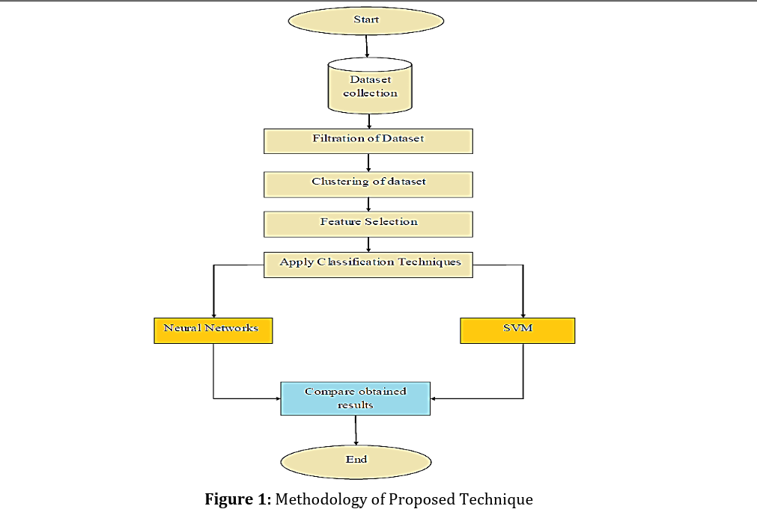
Implementation of Existing System
ARCHITECTURE :

Slide 24
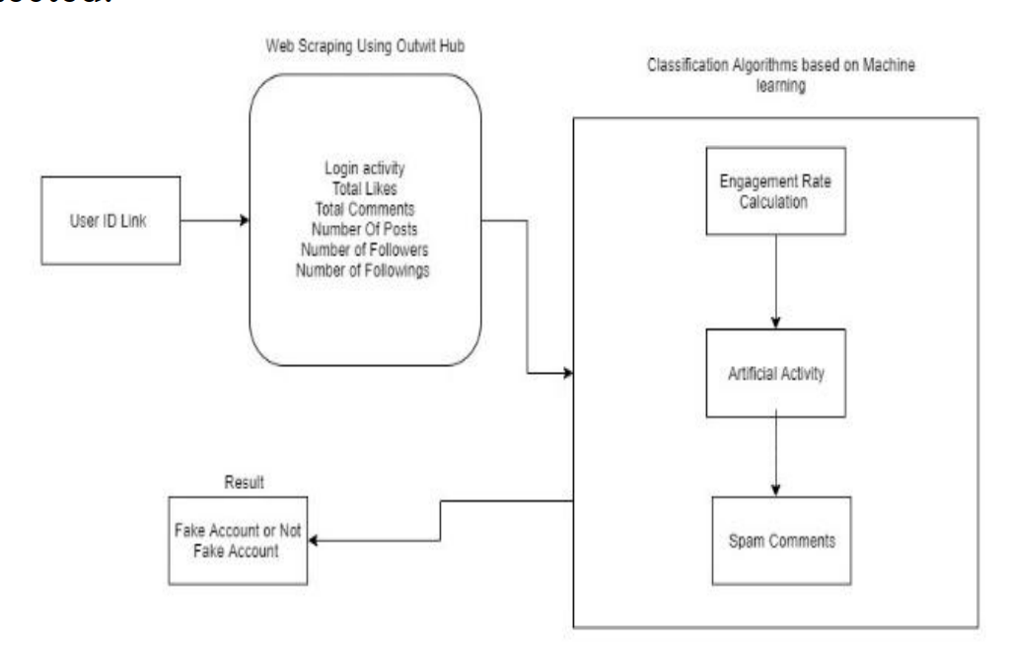

Slide 25
1. IMPLEMENTATION OF FAKE ACCOUNT DETECTION USING MACHINE LEARNING:
This detection method uses gradient boost and extreme gradient boosting algorithms to detect fake accounts. The technologies we have used are Python and Python’s Standard libraries like Numpy, Pandas, Matplotlib, Scipy and Sk learn.
A. Python: Python is our major programming language. It is used for our dataset to detect fake accounts. It provides various tools and libraries that help in detecting fake accounts up to high accuracy levels.

Slide 26
2. IMPLEMENTATION OF FAKE ACCOUNT DETECTION USING NLP:
1.NLP Pre-processing 2. Principal Component Analysis(PCA) 3. Learning Algorithms
Tokenization: Tokenization is the process of breaking a circulate of textual content into phrases, phrases, symbols, or different significant factors called tokens .The aim of the tokenization is the exploration of the phrases in a sentence. The list of tokens turns into input for further processing akin to parsing or textual content mining.

Slide 27
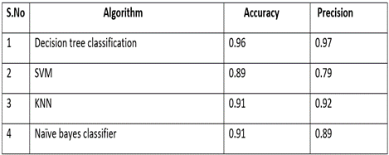
Performance Measure

Slide 28
Result
The fake profile detection project employing neural networks achieved remarkable results with an impressive F1-score of 0.95, emphasizing precision. This signifies a high degree of accuracy in correctly identifying fake profiles while minimizing false positives. The model's precision rate of 0.97 underscores its effectiveness in minimizing false alarms, essential for user trust and platform integrity. The model’s accuracy obtained is 0.96.

Slide 29

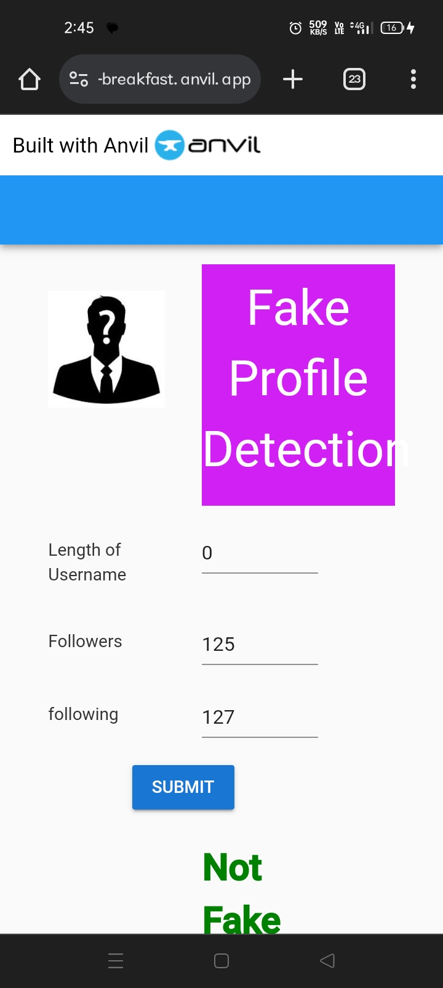

Slide 30
Conclusion
We summarized the studies conducted on fake account identification on online social networking websites. A large number of relevant research published using the global community were compiled and classified into three categories:
research using non-textual (account-based) features
research using textual features
3) research using both textual and non-textual features.
The textual and account-based features have been explained in detail. The researcher may either use existing features or add new features after reviewing the current collection of features to improve the prediction accuracy. OSN websites suffer from a range of huge data volumes, the privacy of user account information, cyberbullying, hate speech, fake profiles, and many others

Slide 31
References
M. Egele, G. Stringhini, C. Kruegel, and G. Vigna, “Towards detecting compromised accounts on social networks,” IEEE Trans. Dependable Secure Comput., vol. 14, no. 4, pp. 447–460, Jul./Aug. 2017.
P. V. Savyan and S. M. S. Bhanu, “Behaviour profiling of reactions in Facebook posts for anomaly detection,” in Proc. 9th Int. Conf. Adv. Comput., 2017, p. 220–226.
M. A. Wani, N. Agarwal, S. Jabin, and S. Z. Hussain, “Analyzing real and fake users in Facebook network based on emotions,” in Proc. IEEE 11th Int. Conf. Commun. Syst. Netw., 2019, pp. 110–117.
K. Chakraborty, S. Bhattacharyya, and R. Bag, “A survey of sentiment analysis from social media data,” IEEE Trans. Comput. Social Syst., vol. 7, no. 2, pp. 450–464, Apr. 2020.

Slide 32
Thank You!

